Slide 1
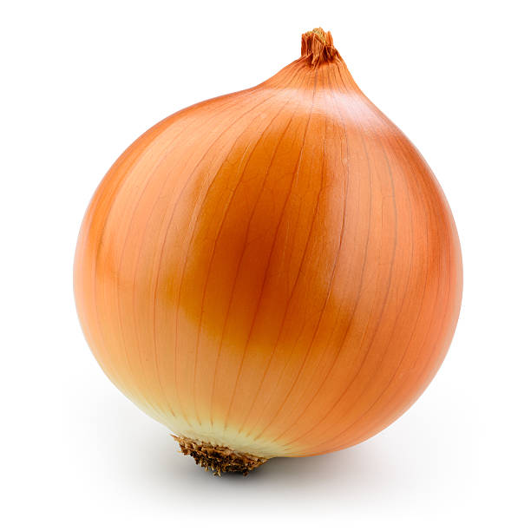


How to peel self-intersecting onions
(or: Homotopic curve shortening)
Sergey Avvakumov
Gabriel Nivasch

Slide 2
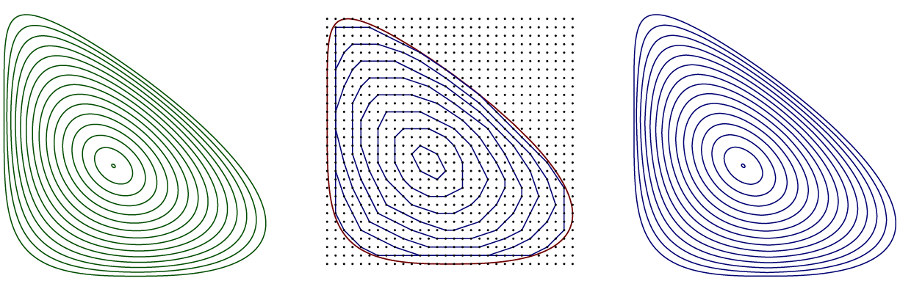
This is a continuation of the work:
“Grid peeling and the affine curve-shortening flow”
D. Eppstein. S. Har-Peled, G. Nivasch, 2018

Slide 3
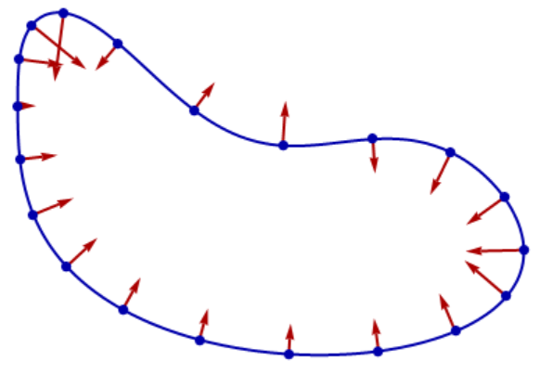
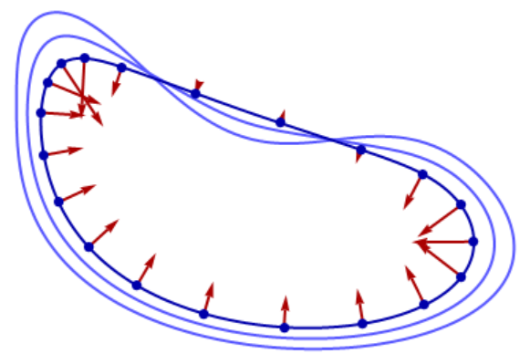
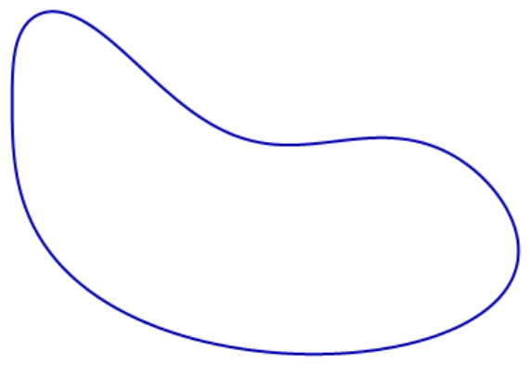
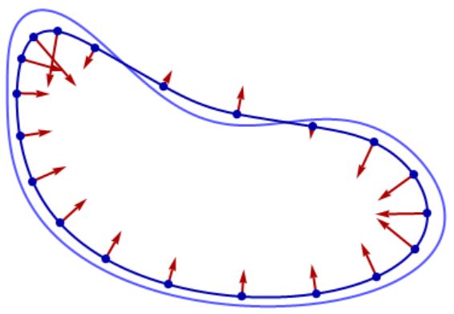
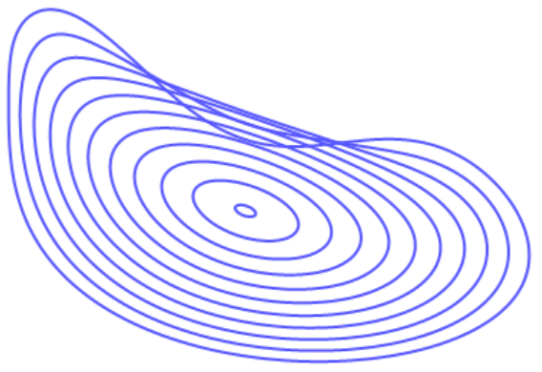
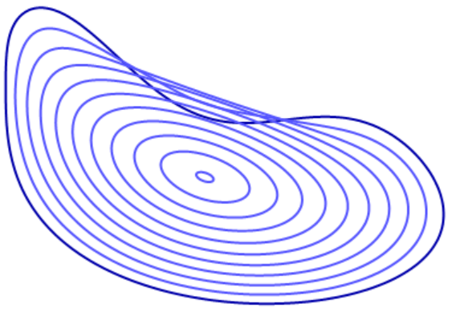
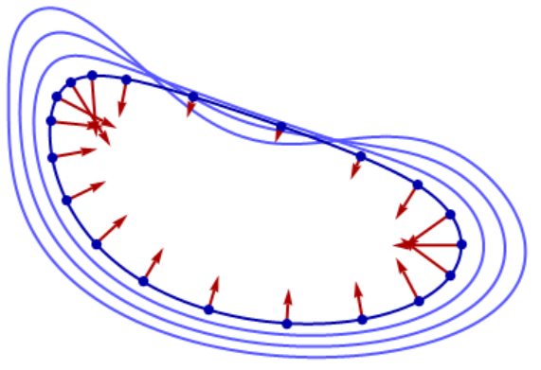
The Affine Curve-Shortening Flow (ACSF)
We are given a closed curve.
The curve evolves with time, as follows:
At each moment in time, each point has speed 1/r^{1/3} pointing towards the local center of curvature.
r = local radius of curvature

Slide 4
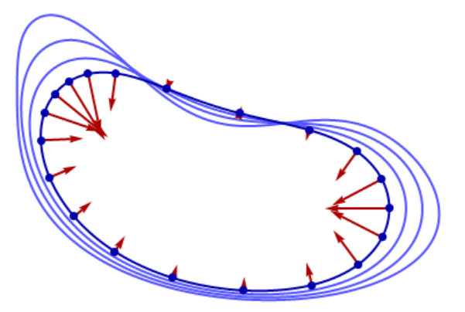
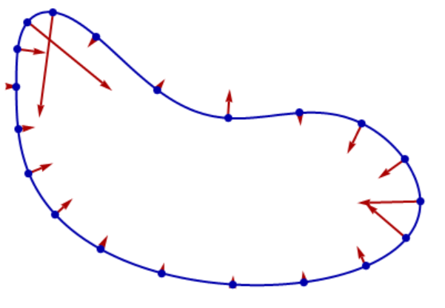
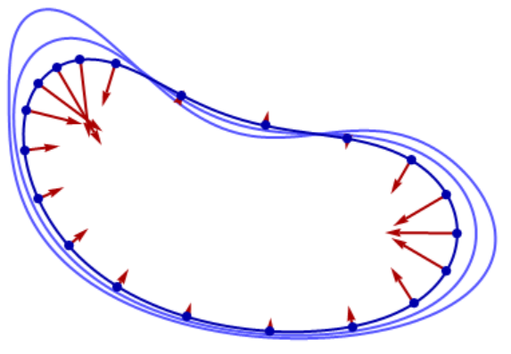
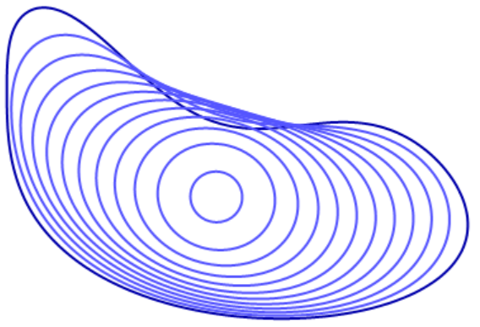
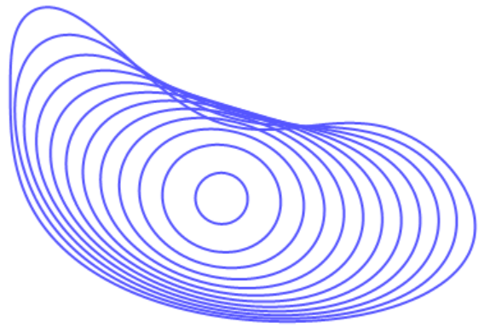
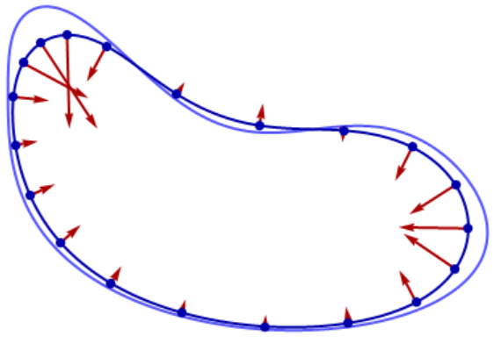
The Curve-Shortening Flow (CSF)
Speed is 1/r

Slide 5
CSF vs. ACSF
Speed is 1/r
Speed is 1/r^{1/3}
A simple curve converges to a circle as it collapses to a point
A simple curve converges to an ellipse as it collapses to a point

Slide 6
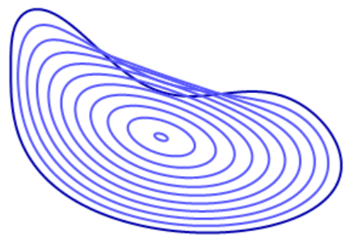
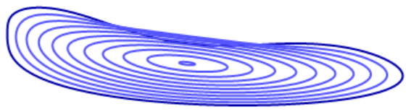
Why 1/3?
The ACSF is invariant under affine transformations:
If the affine transformation is area-preserving, then the time scale is unaffected.

Slide 7


Non-smooth curves
Let’s say we want to start with a square.
How does this even get started?
v = 0
v = ∞
v = 0

Slide 8

Non-smooth curves
A “solution” is a time-dependent curve that satisfies the CSF/ACSF for all t > 0, and converges to the initial curve as t goes backwards to 0.
t → 0
t → 0
CSF
ACSF

Slide 9
Does a unique solution always exist?
For CSF: Yes, even for curves with singularities or self-intersections.
For ACSF: Not known. Existing literature only addresses simple curves.

Slide 10
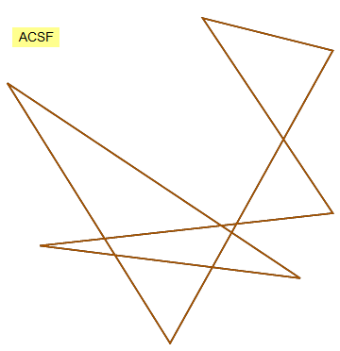
Does a unique solution always exist?
For CSF: Yes, even for curves with singularities or self-intersections.
For ACSF: Not known. Existing literature only addresses simple curves.
But you can still easily simulate CSF or ACSF on the computer!

Slide 11
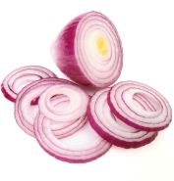
Convex-layer decomposition
Given a finite point set in the plane, we repeatedly remove the vertices of the convex hull.
Not vertices
AKA “Onion decomposition”!

Slide 12
Experimental correspondence [EHN’18]
ACSF
grid peeling 30x30
(every 5th layer shown)
grid peeling 5000x5000
(every 2714th layer shown)

Slide 13

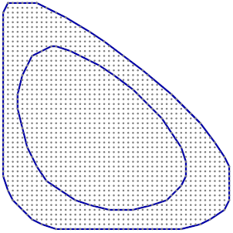
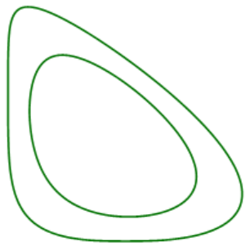
Experimental correspondence:
Take the boundary of R
Run ACSF for some time t
Convex region R
Main Conjecture: Converges as n → ∞
Fill R with a grid of spacing 1/n
Run grid peeling for c t n^{4/3} iterations
c ≈ 1.6 absolute constant
[EHN’18]

Slide 14
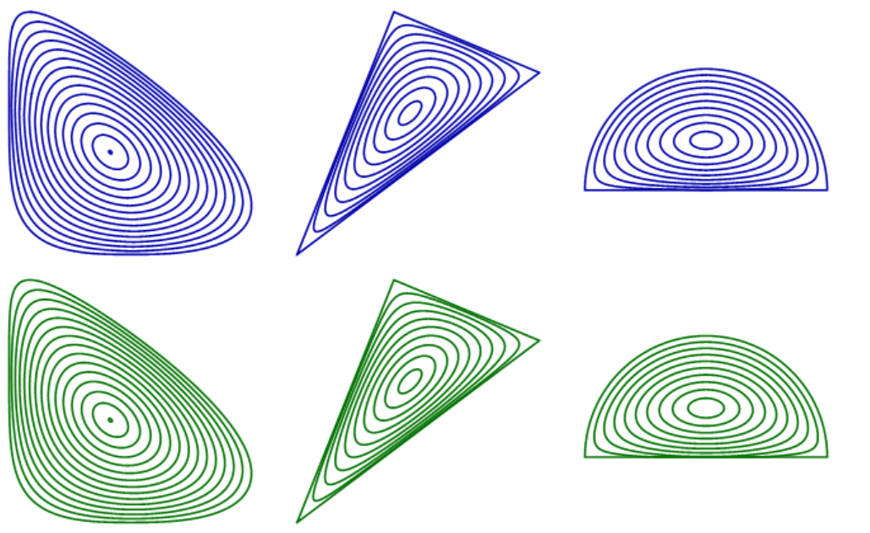
Grid peeling:
ACSF:
[EHN’18]

Slide 15
Open problem in [EHN’18]:
What about non-convex curves?
Our solution:
“Homotopic Curve Shortening”

Slide 16
Homotopic paths and curves
The red and green paths are “homotopic”: They can be continuously transformed into one another, without moving the endpoints, and without touching the obstacles.
t
s
The green and purple paths are not homotopic
Shortest homotopic path
(You are allowed to “touch” obstacles only at the last moment.)

Slide 17
Homotopic paths and curves
The red and green curves are “homotopic”: They can be continuously transformed into one another without touching the obstacles.
The green and purple curves are not homotopic
Shortest homotopic curve

Slide 18
Point obstacles
t
s
Right before the end.
Same as before. Except that when you “touch” obstacles at the last moment, you “lose information”.

Slide 19

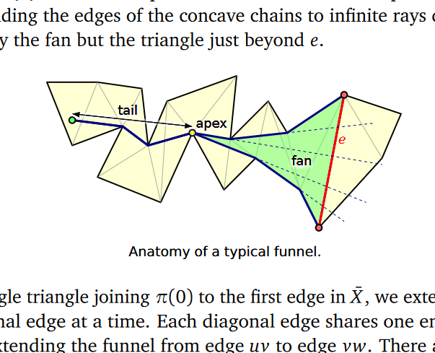
Homotopic paths and curves
Algorithmic problem: Given a polygonal path/curve in the presence of polygonal or point obstacles, to find the shortest path/curve homotopic to it.
“Funnel algorithm” [Chazelle, FOCS 1982; Lee and Preparata, Networks 1984] (also [Tompa, STOC 1980; Leiserson and Maley, STOC 1985])
From Jeff Erickson’s lecture notes on “Shortest Homotopic Paths”

Slide 20
Homotopic Curve Shortening
P
C
P = finite set of point obstacles
A “P-curve” is a polygonal curve whose vertices are in P.
Let C be a P-curve. We define C'=HCS(C) as follows:
At each turn of C at an obstacle, take a small shortcut.
At each point at which C goes straight through an obstacle, put a “nail”.
Take the shortest homotopic curve, without moving the nailed points.

Slide 21
Formally:
1. Splitting. Identify “nailed vertices”: points at which C goes straight through an obstacle. The nailed vertices split C into paths
C₁, …, C_{k}.
C₁
D₁
C
C'₁
D₂
C'
C₂
2. Shortcutting. For each path C_{i}, take a small shortcut around each obstacle, obtaining path D_{i}.
C'₂
3. Shortening. For each D_{i}, take the shortest path homotopic to it, obtaining path C'_{i}. Let C' be the concatenation of the paths C'_{i}.

Slide 22
Homotopic Curve Shortening
1. Splitting. Identify “nailed vertices”: points at which C goes straight through an obstacle. The nailed vertices split C into paths
C₁, …, C_{k}.
If there are no nailed vertices, then there is no splitting. Just shortcutting and shortening on the single curve C.
2. Shortcutting. For each path C_{i}, take a small shortcut around each obstacle, obtaining path D_{i}.
3. Shortening. For each D_{i}, take the shortest path homotopic to it, obtaining path C'_{i}. Let C' be the concatenation of the paths C'_{i}.

Slide 23
Homotopic Curve Shortening: Experiments
Fix an initial curve C. Let P be a very fine uniform grid. Run HCS. Compare it to ACSF on C.

Slide 24
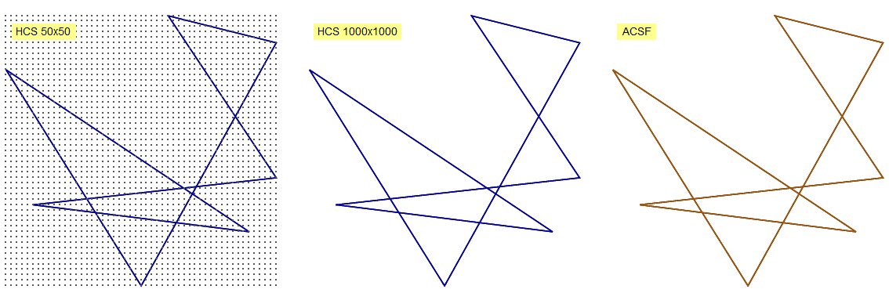
Homotopic Curve Shortening: Experiments
Fix an initial curve C. Let P be a very fine uniform grid. Run HCS. Compare it to ACSF on C.

Slide 25
Homotopic Curve Shortening: Experiments
Imre Bárány: “Random point sets behave like the uniform grid in many cases. Why don’t you try with random point sets?”

Slide 26
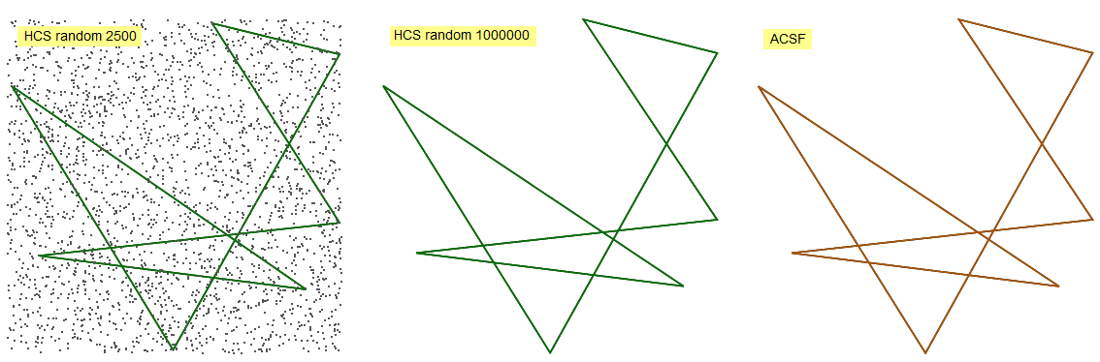
Homotopic Curve Shortening: Experiments
Imre Bárány: “Random point sets behave like the uniform grid in many cases. Why don’t you try with random point sets?”

Slide 27

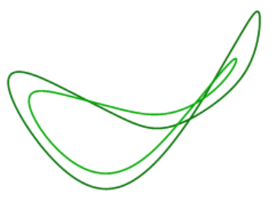
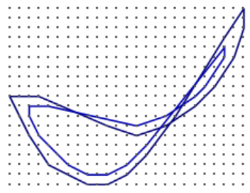
Experimental correspondence:
Initial curve
Run ACSF for some time t
Conjecture 1: Converges as n → ∞
Take a grid of spacing 1/n
Run HCS for c_{g} t n^{4/3} iterations
c_{g} ≈ 1.6 absolute constant

Slide 28
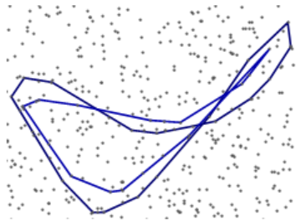
Experimental correspondence:
Initial curve
Run ACSF for some time t
Conjecture 2: Converges as n → ∞
Fill bounding box, of area A, with An² random points
Run HCS for c_{r} t n^{4/3} iterations
c_{r} ≈ 1.3 absolute constant

Slide 29
Experimental correspondence
Grid proportionality constant: c_{g} ≈ 1.6
(Same as in [EHN’18])
Random proportionality constant: c_{r} ≈ 1.3
Determined experimentally

Slide 30
Theoretical results
We have no idea how to prove these conjectures
Can we at least prove that HCS shares some simple properties with ACSF?

Slide 31
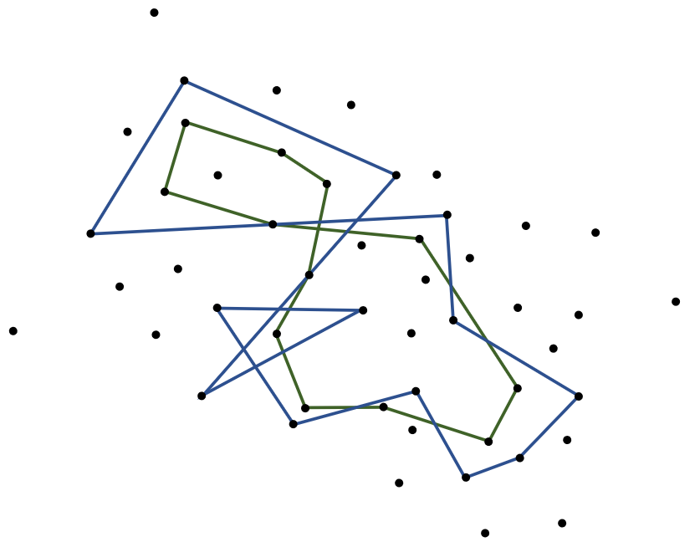
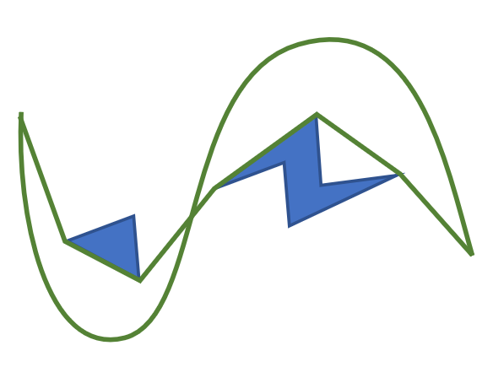
Theoretical results
Theorem 1: HCS is invariant under affine transformations.
This is an immediate consequence of:
Claim: Shortest homotopic curves are invariant under affine transformations.

Slide 32
Theoretical results
Claim: Shortest homotopic curves are invariant under affine transformations.
Wait! Are you sure?? Affine transformations do not preserve distances!
Proof to come!

Slide 33
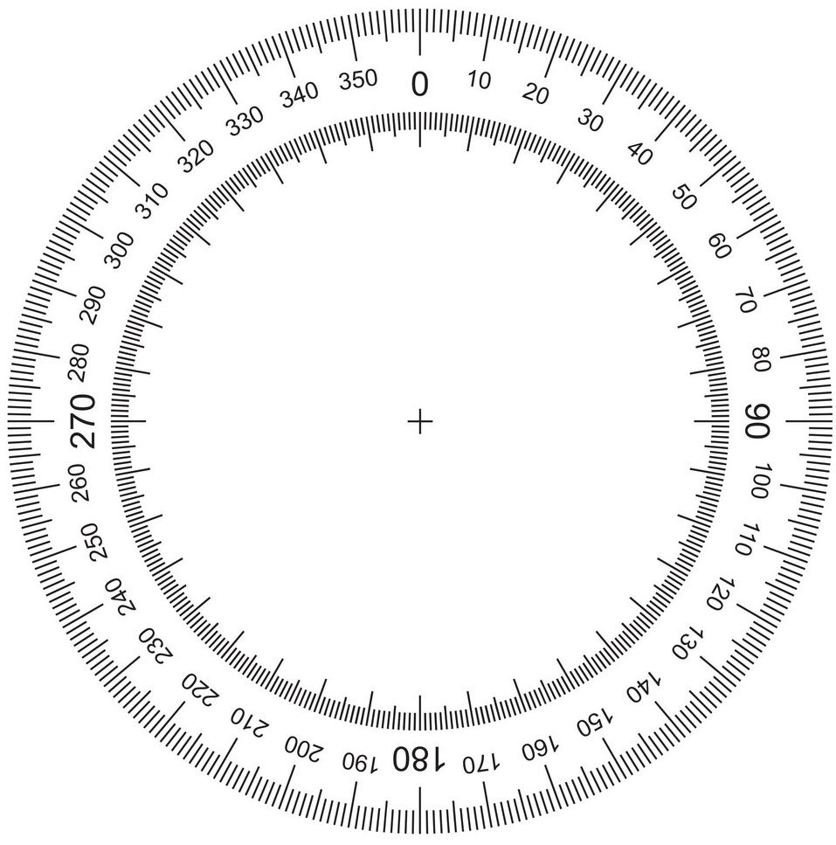
Total absolute curvature
The total absolute curvature of a curve C is the total angle you turn when going around C, when turning CW and CCW are both considered positive.
Convex curve: Total absolute curvature = 2π
Otherwise: Total absolute curvature > 2π

Slide 34
Total absolute curvature
Under ACSF, the total absolute curvature decreases until it settles at 2π (the curve becomes convex).
Total absolute curvature of a polygonal curve: Sum of the exterior angles.
Theorem 2: Under HCS, total absolute curvature does not increase.

Slide 35
Avoidance principle
ACSF satisfies the “avoidance principle”:
If two curves are initially disjoint, then they stay disjoint at all times.
A simple curve (no self-intersections) stays simple at all times.
Proof:
The blue curve part moves slower than the red one.

Slide 36
Avoidance principle
Does HCS also satisfy the avoidance principle?
These two curves are not disjoint, but they are disjoinable: They can be transformed into disjoint curves by an arbitrarily small perturbation (for all ε > 0…).
No…
This curve is self-disjoinable: It can be transformed into a simple curve by an arbitrarily small perturbation.

Slide 37
Disjoinable and self-disjoinable curves/paths
Consider the path a b c d c f c b c d e. Is it self-disjoinable?
No.
a
b
c
d
e
f
[Akitaya, Aloupis, Erickson, Tóth 2017]: An O(n log n)-time algorithm for recognizing self-disjoinable curves (a.k.a. weakly simple polygons).

Slide 38
Theoretical results
Theorem 3:
If the initial P-curve is self-disjoinable, then it stays self-disjoinable at all times under HCS.
If two initial P-curves are disjoinable, then they stay disjoinable at all times under HCS.
More generally:
A curve is called self-transversal if all its self-intersections are transversal.
Two curves are called transversal if all the intersections between them are transversal.
Transversal intersection

Slide 39
Theoretical results
The self-intersection number of a curve C is the minimum number of intersections of a self-transversal curve C' that is ε-close to C, for all sufficiently small ε > 0.
The intersection number between two curves C₁, C₂ is the minimum number of intersections between transversal curves C'₁, C'₂ that are ε-close to them, for all sufficiently small ε > 0.
[Fulek, Tóth 2018]: Calculating the self-intersection number of a given curve is NP-hard.
Theorem 3 more generally: HCS does not increase intersection nor self-intersection numbers.

Slide 40
Theoretical results
Corollary: HCS on a P-curve does not take more iterations than the convex-layer decomposition of P.
Proof:

Slide 41
The avoidance principle revisited
A set of obstacle points P is in general position of no three points are collinear.
If P is in general position then there are no nailed vertices in HCS.
Theorem 4: Let P be in general position. Then, under HCS, a simple curve stay simple, and two disjoint curves stay disjoint.

Slide 42


Inflection points in ACSF
In ACSF, the collapse of a self-intersection might create inflection points:
But in a simple curve, the number of inflection points never increases.

Slide 43
Inflection edges in HCS
Let C be a simple polygonal curve. Each vertex of C is either CW or CCW.
The number of inflection edges is always even.
An inflection edge is an edge that lies between a CW vertex and a CCW vertex.

Slide 44
Inflection edges in HCS
A self-disjoinable curve can be perturbed into simple curves with different numbers of inflection edges:
C = a b a b a b a b a
6 inflection edges
a
b
2 inflection edges
Let C be a self-disjoinable polygonal curve. Its inflection-edge number is the smallest number of inflection edges of a simple polygonal curve ε-close to C, for all sufficiently small ε > 0.
Theorem 5: HCS does not increase the inflection-edge number of a self-disjoinable curve.

Slide 45
Two algorithms for shortest homotopic curves/paths
Input:
Desired output:
s
t
s
t
or

Slide 46
Algorithm 1: Triangulation
Triangulate the ambient space, using obstacle vertices as the triangle vertices.
j
k
m
c
C
l
b
a
t
s
i
n
Take the triangle-edge sequence E(C):
h
o
g
abccbadefghicjkllmnoghibbihgon
d
f
e

Slide 47
Algorithm 1: Triangulation
v
v
Effect on E(C) of a continuous homotopic change in C:
u
w
u
w
…uw…
…uvvw…
If E(C) has adjacent repetitions, then C cannot be homotopically shortest. So eliminate all adjacent repetitions from E(C), obtaining a reduced sequence E'.
(Lemma: The reduced sequence is always unique.)
E(C) = abccbadefghicjkllmnoghibbihgon
E' = defghicjkm

Slide 48
Algorithm 1: Triangulation
E' = defghicjkm
j
k
m
Now slide the vertices along the triangulation edges to their optimal positions.
c
C
l
b
a
t
s
For this we need the funnel algorithm.
Details skipped.
n
i
h
o
g
d
f
e

Slide 49
Algorithm 2: Vertex releases
Stable vertex
Unstable vertex: No obstacle, or obstacle on side of angle >π
C
Stable vertex: Obstacle on side of angle <π
Unstable vertices
Releasing unstable vertex v:
The algorithm: Release unstable vertices one by one, in an arbitrary order, until none remain.
v
Take all obstacle vertices in Δuvw, excluding v.
Take the boundary of their convex hull.
Here w becomes unstable
u
w

Slide 50
Algorithm 2: Vertex releases – with point obstacles
Added complication: For each vertex we have to remember the turning angle of the curve at that vertex.
For point obstacles, the angle could be larger than 2π.
A vertex is unstable if and only if its turning angle is between -π and π.

Slide 51
Summary of proof techniques
T = Triangulation algorithm VR = Vertex-release algorithm
Theorem | Proof technique
Correctness of vertex-release algorithm | T
Theorem 1 (invariance under affine transformations) | VR
Theorem 2 (total absolute curvature) | VR
Theorem 3 (intersection numbers) | T or VR
Theorem 4 (P in general position) | T (or VR)
Theorem 5 (inflection edges) | VR

Slide 52
Proof of Theorem 1
Theorem 1: HCS is invariant under affine transformations.
This is an immediate consequence of:
Claim: Shortest homotopic curves are invariant under affine transformations.

Slide 53
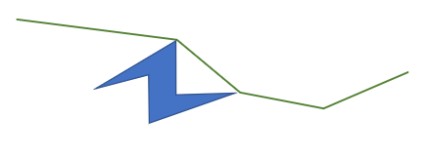
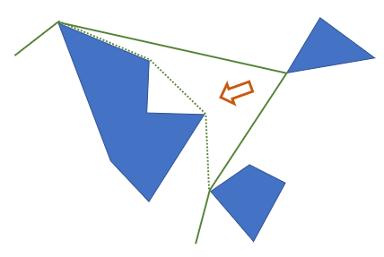
Proof of the claim: This is an immediate consequence of:
Vertex stability/unstability is invariant under affine transformations,
Vertex release is invariant under affine transformations.
QED Theorem 1

Slide 54
Proof of Theorem 2
Theorem 2: Under HCS, total absolute curvature does not increase.
Proof: Given a polygonal curve C, for each edge e_{i}, let v_{i} in S¹ be the corresponding unit tangent vector.
v₃
v₁
e₁
e₄
e₂
e₅
e₃
v₅
v₄
v₂
Then the total absolute curvature of C equals the length of the shortest tour of S¹ that visits e₁, e₂, …, e_{n}, e₁.

Slide 55
Effect of a vertex release:
v₁
u₁
u₂
u₃
u₄
v₂
The shortest tour of the old vector sequence is a valid tour of the new vector sequence.
QED Theorem 2

Slide 56
Proof of Theorem 3
Theorem 3: HCS does not increase intersection nor self-intersection numbers.
Proof idea: Case of self-intersections:
HCS
C
C'
Self-transversal curve ε-close to C, with minimum number of self-intersections
We will show:
D'
Self-transversal curve ε-close to C'
D
Without increasing # of self-intersections

Slide 57
Make sure curve passes on the “correct” side of each obstacle (like in “shortcutting” step of HCS)
D
“Snap”
This doesn’t increase # of self-intersections
Tiny circle

Slide 58
Introduce a triangulation of the ambient space.
Remove adjacent repetitions “ee” in the edge sequence
Nailed
Nail this
C
e
e
D
This can be done without increasing # of self-intersections

Slide 59
On each triangulation edge, slide the vertices to within ε of their final positions.
Do not switch order of vertices, unless necessary.
C
C'
1
2
3
4
5
3
1,2,5
4
D
D'
1
2
3
4
5
3
1 2 5
4

Slide 60
What can happen to intersections when we slide the vertices?
before sliding
after sliding
Vertices switched positions
Intersection destroyed
Intersection created
Intersection created
Run of consecutive vertices that switched positions
Intersection created or destroyed
In general:
Can we have here another intersection created?

Slide 61

The answer is no:
after sliding
Intersection created
Intersection created
Mix & match gives a shorter curve. Contradiction
Some important details have been skipped!
The case of 2 curves is similar.
QED Theorem 3

Slide 62
Proof of Theorem 4
Theorem 4: Let P be in general position. Then, under HCS, a simple curve stay simple, and two disjoint curves stay disjoint.
Proof: Suppose P is in general position. Suppose C is simple. Let C'=HCS(C).
We need to show C' is simple. We already know C' is self-disjoinable (Theorem 3).
How can C' be self-disjoinable but not simple? If an obstacle point is visited twice:
D' is simple
C'
D'

Slide 63
Here are the two vertices after the slide.
Where were they before the slide?
1
They didn’t switch positions.
2
D'
Option 1:
Option 2:
1
1
2
2

Slide 64
Before the slide, option 1:
After the slide:
1
shorter
2
C
1
D'
But how did 1 slide across the blue edge?
Some run of consecutive points slid across the blue edge.
But they shouldn’t have.
Contradiction

Slide 65
Before the slide, option 2:
After the slide:
1
shorter
1
2
C
D'
Contradiction
The case of 2 curves is similar.
QED Theorem 4

Slide 66
Proof of Theorem 5
Theorem 5: HCS does not increase the inflection-edge number of a self-disjoinable curve.
Proof idea:
C
C' = HCS(C)
vertex releases
If done in the proper order, the curve stays self-disjoinable at all times.
No vertex release increases the number of inflection edges.

Slide 67
Proof details:
Simple polygonal curve ε-close to C, with minimum number of inflection edges
C
Self-disjoinable curve
D
Simple curve composed of straight parts and circular parts of slightly different radii
“Type-3 curve”

Slide 68
“Type-3 curve”
We define “inflection edges” on type-3 curves.
We perform vertex releases on type-3 curves:
Handling nailed vertices: We “nail” the corresponding circular arcs of the type-3 curve.

Slide 69
In which order to release vertices?
In a given obstacle, always release the arc with the largest radius.
For new arcs, make their radius the largest one.
This way, no self-intersections are created: If there were a self-intersection after the release, there would also be a self-intersection before the release.
Nailed arcs always have smaller radius than non-nailed arcs.
This argument re-proves Theorem 3 (“HCS does not increase # intersections”), using the vertex-release algorithm.

Slide 70
Claim: No vertex release increases the number of inflection edges.
(Proof skipped.)
After all the vertex releases, we obtain a polygonal curve by replacing the circular arcs by straight lines.
This might create slight inflection edges, at places where C' goes straight through an obstacle.
Just straighten out.
Details skipped!
QED Theorem 5

Slide 71
Summary
We introduced “HCS”, a generalization of the onion decomposition.
We showed an experimental connection between HCS and ACSF.
ACSF “occurs in nature”!
We proved some simple properties that HCS satisfies and shares with ACSF.

Slide 72
Open problems
(For differential geometers): Prove that ACSF is uniquely defined past singularities, like CSF.
Prove the HCS-ACSF conjecture.
What happens in higher dimensions??

Slide 73


