Slide 1
Simple Topological Drawings of k-planar Graphs
Authors: Chih-Hung Liu, Meghana M. Reddy, Csaba D. Tóth
Meghana M. Reddy
meghana.mreddy@inf.ethz.ch
D-INFK, ETH Zürich
March 16, 2020
<number>

Slide 2
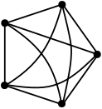
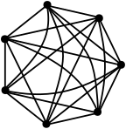
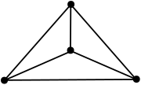
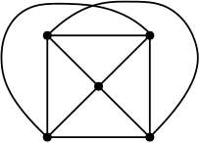
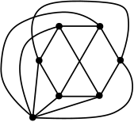
Planarity of a graph
Maximum #crossings per edge
k-planar graph: has a drawing with at most k crossings per edge
“local crossing number”
K₄ : planar
K₅ : 1-planar
K₇ : 2-planar
<number>

Slide 3
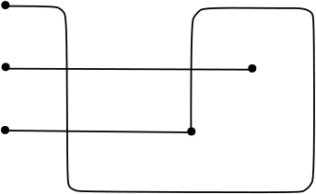
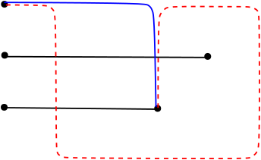
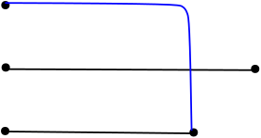
Crossing number of a graph
Total #crossings in a drawing
“Graph crossing number”
<number>

Slide 4
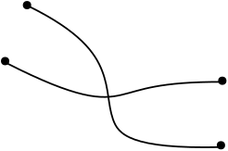


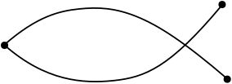
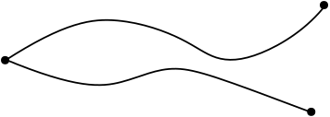
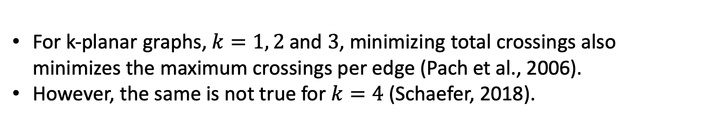
Simple Topological Drawings
Any two edges have at most one point in common.
X
X
“Simple local crossing number”
“local crossing number” vs “simple local crossing number”
For k-planar graphs, and , minimizing total crossings also minimizes the maximum crossings per edge (Pach et al., 2006).
However, the same is not true for(Schaefer, 2018).
<number>

Slide 5
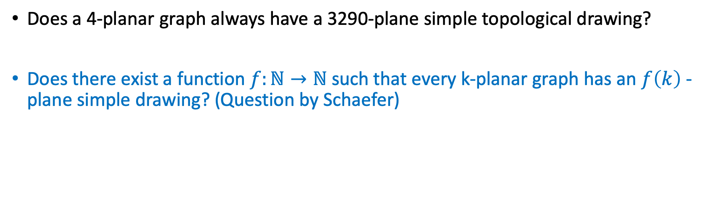
Simple drawings of k-planar graphs
Does a 4-planar graph always have a 3290-plane simple topological drawing?
Does there exist a function such that every k-planar graph has an -plane simple drawing? (Question by Schaefer)
Yes!
<number>

Slide 6
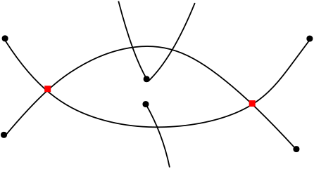
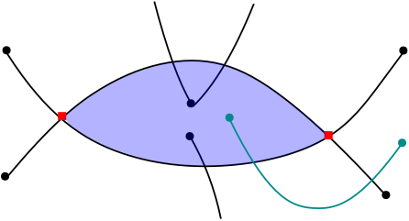
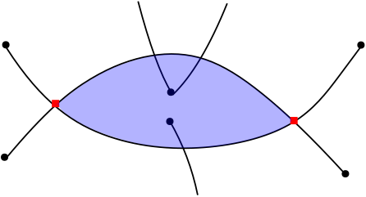
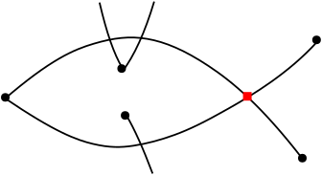
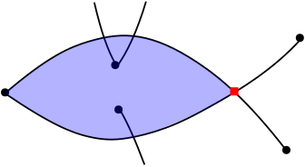
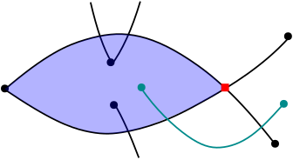
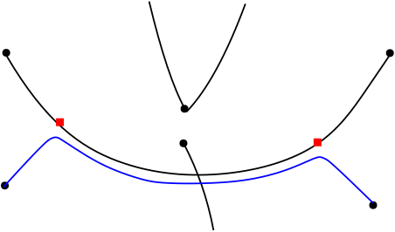
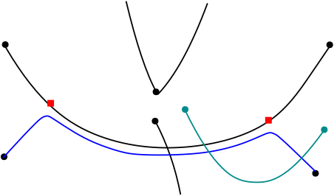
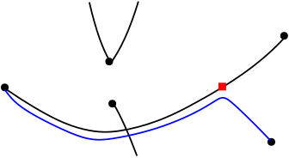
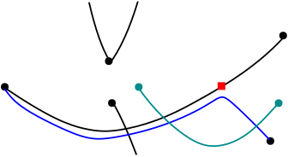
Idea: Rerouting the edges
“Lens”
“Arcs”
<number>

Slide 7
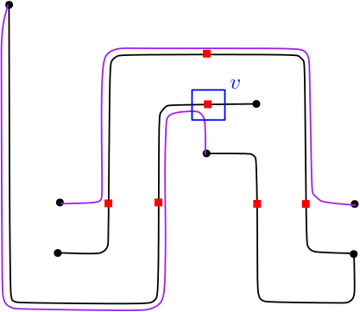
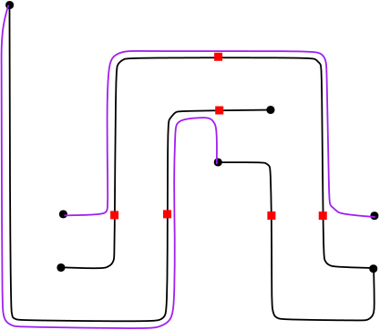
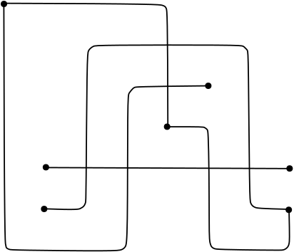
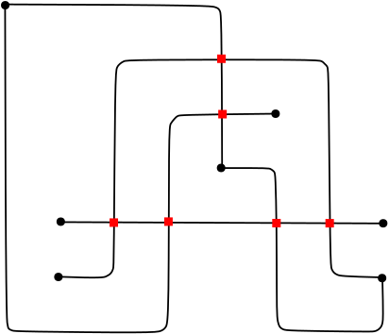
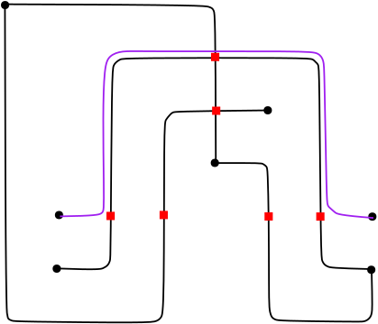
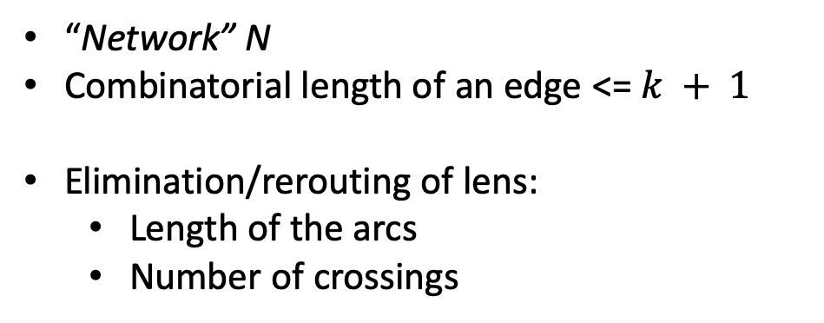
Planarization approach
2
“Network” N
Combinatorial length of an edge <=
Elimination/rerouting of lens:
Length of the arcs
Number of crossings
2
5
3
2
Maximum crossings per edge is bounded!
0
Crossings in a small neighborhood of a node of N.
<number>

Slide 8
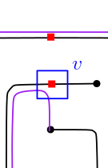
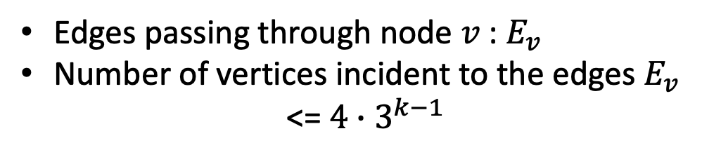
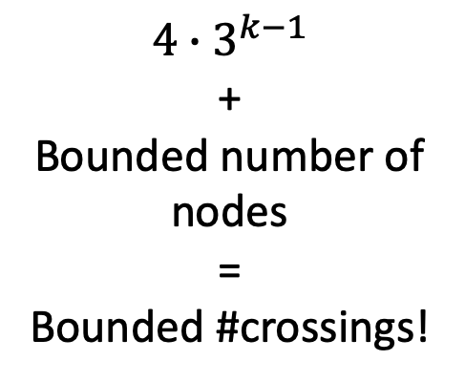
Planarization approach
Edges passing through node :
Number of vertices incident to the edges
<=
+
Bounded number of nodes
=
Bounded #crossings!
<number>

Slide 9
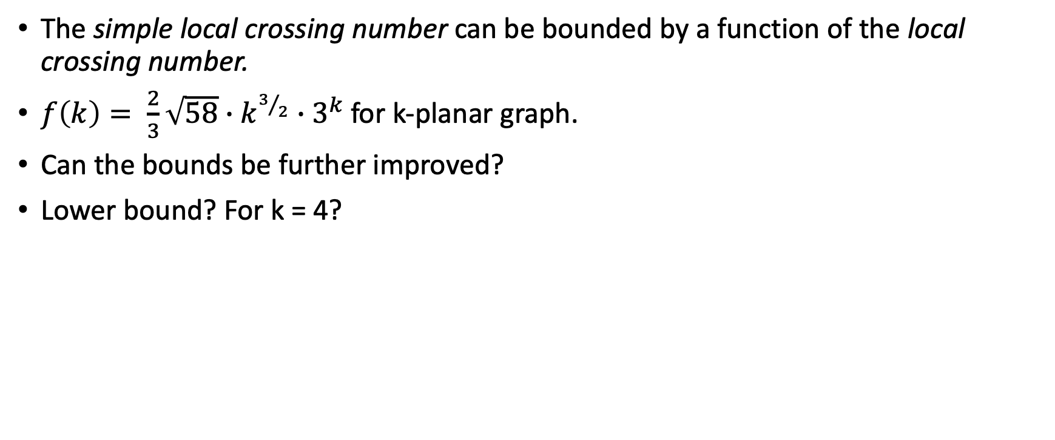
Conclusion
The simple local crossing number can be bounded by a function of the local crossing number.
for k-planar graph.
Can the bounds be further improved?
Lower bound? For k = 4?
Thank you!
<number>

